Slide 1
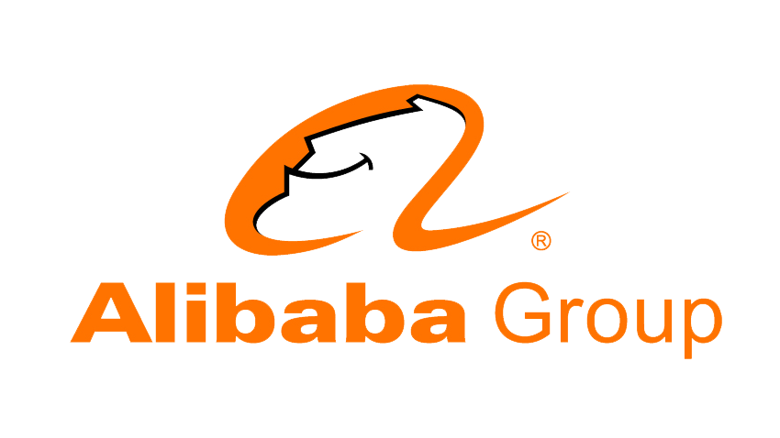
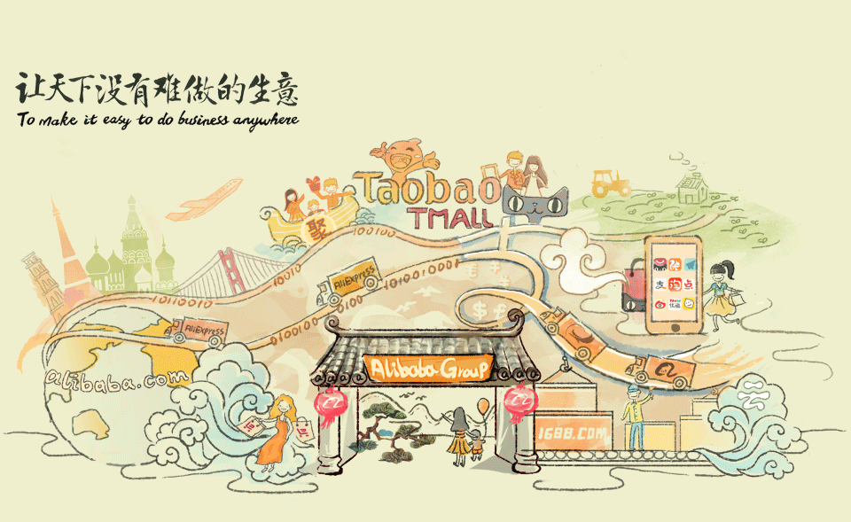
Notes:
Alibaba Group Holding Limited is a Chinese multinational conglomerate specializing in e-commerce, retail, Internet, AI and technology.

Slide 2
Alibaba.com is a business to business(B2B) ecommerce website, much like eBay retail, but focusing on manufacturing and business services. Alibaba wants to be the new middle man.
They do this by helping business establish their presence online through user friendly standardized formats for profiles and catalogues. They help businesses find potential trading partners. They also are a transaction platform. This means that their website is place to begin the process of buying and selling.
Today Alibaba has around 17,000 Employees in more than 50 Cities with 50 Million Users spread across 240 Countries.
Notes:
ALIBABA GROUP WAS FOUNDED IN 1999 BY 18 PEOPLE LED BY JACK MA, a former English teacher from Hangzhou, China.
Today Alibaba has around 17,000 Employees in more than 50 Cities with 50 Million Users spread across 240 Countries.
With operations in over 200 countries,^{[9]} Alibaba is the world's largest retailer, one of the largest Internet and AI companies, one of the biggest venture capital firms, and one of the biggest investment corporations in the world

Slide 3
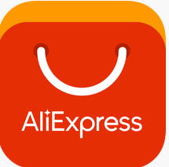
Companies and affiliated entities
E-commerce and retail service platforms
Alibaba.com
AliExpress
Taobao
Tmall
Cloud Computing and AI technology
Alibaba Cloud
AliGenie
AliOS
Fintech and Online Payment Platforms
Alipay
Entertainment services
AliMusic
Alibaba Pictures
Others
AliHealth
AliSports

Slide 4
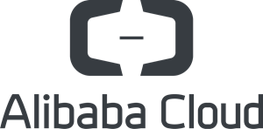
Since 2011, Alibaba Group has been actively involved in building open source communities, with the number of open source projects increasing every year.
Alibaba and Alibaba Cloud have fostered a culture that encourages our teams to voluntarily contribute to various open source projects, either by sharing experiences or helping others to solve problems
Alibaba Cloud provides cloud computing services to online businesses and Alibaba Group's own e-commerce ecosystem.
Alibaba Cloud offers cloud services. Services are available on a pay-as-you-go basis and include data storage, relational databases, big-data processing, Anti-DDoS protection and content delivery networks (CDN).
Notes:
DDoS:
Distributed Denial of Service

Slide 5

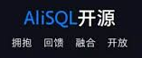
AliSQL
AliSQL is a MySQL branch, developed by Alibaba Cloud database team, and is servicing Alibaba's business and Alibaba Cloud's RDS. AliSQL version is verified to run many Alibaba workloads and is widely used within Alibaba cloud.
AliSQL does a lot of enhancement in the features and performance based on MySQL. It has more than 300 patches, They have added many monitor indicators, features, and optimized it for different user cases. enhancements from the other branches like Percona, MariaDB, WebScaleSQL, and also contains a lot of patches with Alibaba's experiences.
In general test cases, AliSQL has 70% performance improvement over official MySQL version, according to R&D team's sysbench benchmarks.

Slide 6
In comparison with MySQL, AliSQL offers:
Better support for TokuDB, more monitoring and performance optimization.
CPU time statistics for SQL queries.
Sequence support.
Add Column Dynamically .
ThreadPool support. And a lot of Bugfix and performance improvements.
Future:
Now open source AliSQL is the best contribution they have made to the community. They hope to continue their open source journey in future. Full cooperation with the open source community can make the MySQL/MariaDB ecosystem more robust.
Notes:
TokuDB is an open source, high performance storage engine for MySQL and MariaDB. Uses fractal tree index.
LAMP Stack and PHP sdks to run on cloud platforms
Alibaba is the world's largest retailer, one of the largest Internet and AI companies, one of the biggest venture capital firms, and one of the biggest investment corporations in the world. Its online sales and profits surpassed all US retailers (including Walmart, Amazon and eBay) combined since 2015.^{[15]}

Slide 7
Thank you

